Slide 1
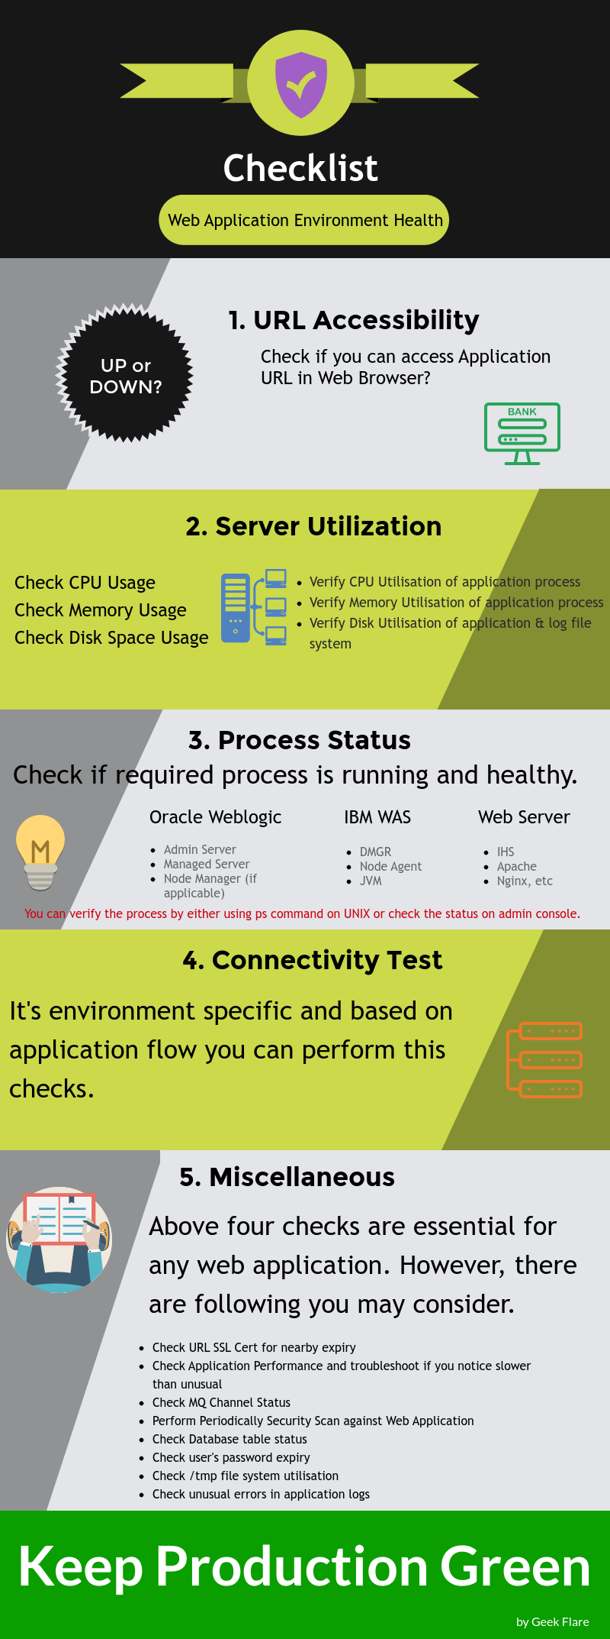
Application health check
Application health monitoring is the practice of tracking the inputs and outputs of an application based on key metrics, logs and traces in order to watch how an application performs over time.
Application health checks are when you define “healthy” parameters for the monitoring metrics across your application and run regular checks to ensure the system is performing the way it’s expected to.

Slide 2
Application health check
Application metrics to watch
1) User Satisfaction
Define a goal for “health” when it comes to the length of time it should take for web requests or transactions to execute in your application. Then, measure those on a scale between great (fast), good (okay), bad (slow) and failed. You can then assess the overall success of transactions and requests across your entire application and determine how customers really experience your services.
2) Latency
Identifying benchmarks for latency and tracking it through the entire architecture will show where there are lags in performance and how it could potentially carry through the system into customer experiences.
3) Traffic
How much traffic is going through your system at a given time? Are there predictable times of day where the traffic will spike? How do you scale the application and infrastructure to handle peak traffic? You can track the rate of requests and transactions in your application to understand when you’re getting the most traffic and prioritize where you need to improve scalability and add flexibility.
4) Error rates
How often do requests fail? How many logged errors are coming from the application and what’s the number of exceptions being thrown? Tracking error rates over time across disparate services can create a more observable application and allow you to more easily report on overall performance. Identifying frequent errors in production quickly can lead to faster incident response and remediation – fixing problems before customers even notice them.
5) Automation in scalability and counting application instances
How often are you spinning up new instances of your application? What are the overall effects on the infrastructure and what can you do to ensure more performant auto-scaling? You can track certain metrics such as number of server instances, CPU usage or ETL and associate auto-scaling rules with those metrics to ensure the system automatically grows as the business grows. Automation in scalability and cloud application health monitoring is about finding the balance between the costs of auto-scaling cloud infrastructure such as AWS or GCP and not harming customer expectations.
6) CPU and disk usage
As mentioned above, disk usage and CPU usage are commonly tracked in application health monitoring. Then, you can set thresholds around those metrics and run regular application health checks to make sure they’re consistently at healthy levels.
7) Overall availability
At the end of the day though, customers simply expect the application to work. So, you should track application availability and uptime over time and use that information to determine service level agreements (SLAs) with customers. An SLA can tell a customer how often they can expect the application to be available (e.g. 99.9% of the time). If the service ever drops beneath a given SLA, many companies will offer some sort of credit to the customer. Availability is the end-all-be-all metric to show the overall reliability of your product at a single glance.

Slide 3
Application health check
Application health check automation
With better monitoring, you can begin to run better application health checks. You can determine thresholds based on the metrics and logs you track and automate health checks around those numbers. It’s important to spend time reviewing the importance of individual services and how often health checks should run through the system and report back into a dashboard of some kind. As with most other DevOps disciplines, automation in the application health monitoring and health checks process can create more efficient teams and surface more information faster.
Alerting and incident response
Once you’re running regular application health checks and consistently monitoring the right parts of your applications and infrastructure, you can link up your alerting and on-call incident response workflows. If an application health check fails and a metric surpasses a certain threshold, you can automatically notify an on-call responder to jump onto the issue. And, with more automation, you can automatically serve that alert to the person or team that owns the given service.
Building dashboards for application health
Dashboards are essential to application health monitoring and knowing when health checks are failing or succeeding. Visualizations will help on-call engineers quickly digest information, see exactly where problems lie and identify when they first started. Dashboards allow you to extend visibility into disparate services as well as overall system health in a centralized place. So, more people have access to pertinent information and can efficiently escalate issues and collaborate cross-functionally with the proper engineering and IT teams.

